Slide 1
Learning-NUM: Network Utility Maximization With Unknown Utility Functions and Queueing Delay
Xinzhe Fu, Eytan Modiano
IEEE/ACM TRANSACTIONS ON NETWORKING, VOL. 30, NO. 6, DEC. 2022
Burak Bozdağ – 504211552

Slide 2
Introduction
Network utility maximization
Fundamental problem in communication networks
Unknown utility functions and queueing delay
Learning-NUM: Maximizes utility over time
Notes:
NUM studies the problems of allocating traffic rates to network users in order to maximize the users’ total utility subject to network resource constraints.
Problems: Congestion control, power allocation, job scheduling
Algorithm gradually learns the utility functions and makes rate allocation and network scheduling/routing decisions to maximize utility.
Queueing delay also depends on decisions (solved with parallel-instance paradigm)

Slide 3
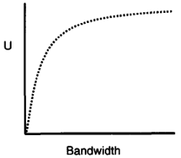
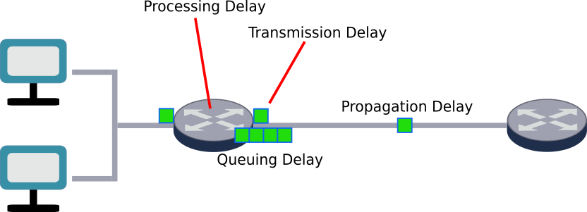
Background
Utility functions:
Defined over [0, +∞)
Continuously differentiable
Non-decreasing
Concave
Queueing delay
Notes:
Communication networks:
[0, +∞) is because of non-negative resource allocation
Queueing delay: the time a job waits in a queue until it can be executed

Slide 4
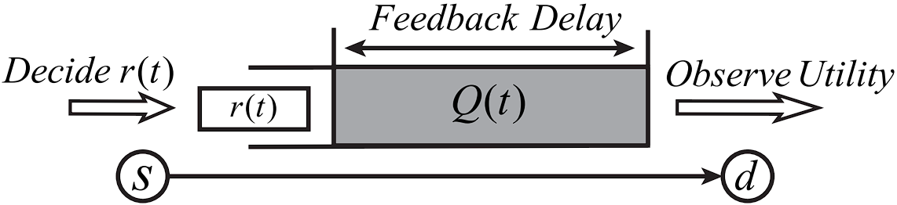
Challenges
Utility functions and queueing delay are unknown
Optimizing an unknown function
Delays depends on decisions
Notes:
Utility functions are unknown and we try to optimize it
Queueing delay depends on decisions of the policy (algorithm)
Figure: A single-queue example illustrating the queueing-style feedback delay in the Learning-NUM framework.

Slide 5
Related Work
Static – stochastic approaches
Utility functions are known
When utility depends on more constraints, it gets hard to estimate
Notes:
Two NUM work categories: static and stochastic
Static: the traffic rates are modeled as flow variables, the bandwidth constraints are modeled as network flow constraints, and the analysis focuses on the convergence rates of the optimization algorithms
Stochastic: the traffic rates are determined by the time-average admitted traffic, the resource constraints are captured by the long-term stability of the stochastic queueing networks and the analysis focuses on the tradeoff between the long-term average utility and queue length
All assume that utility functions are known
when the utility represents more concrete quantities such as power and energy consumption of network links, user satisfaction of the quality of video streaming services and completion quality of computation jobs on the clouds, often we do not have prior knowledge of the utility functions

Slide 6
Learning-NUM
A new framework
Utility values can be learned over time
Value is observed after the job gets to the destination
Determines job sizes and actions
Notes:
In Learning-NUM framework, utility functions are unknown but their values can be learned over the process of decision making.
the utility value of a job can only be observed after the job gets delivered to the destination as feedback from the destination
a policy that jointly determines the job sizes and network actions based on the utility function values learned from observations

Slide 7
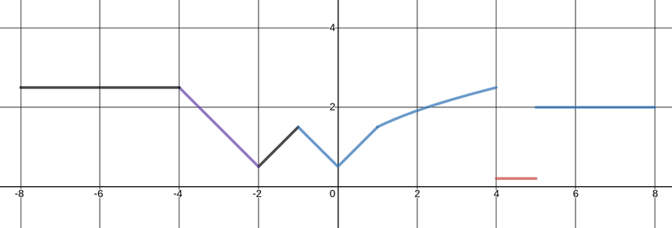
Learning-NUM
Online learning: Minimizing regret value
Regret: Gap between expected and optimal
Gradient sampling
Notes:
Regret: the gap between the expected utility of the policy and that of the optimal policy that has full knowledge of the utility functions in advance
Gradient sampling: extending the steepest descent methodology to the minimization of non-smooth, nonconvex functions
Figure is non-smooth nonconvex function example

Slide 8
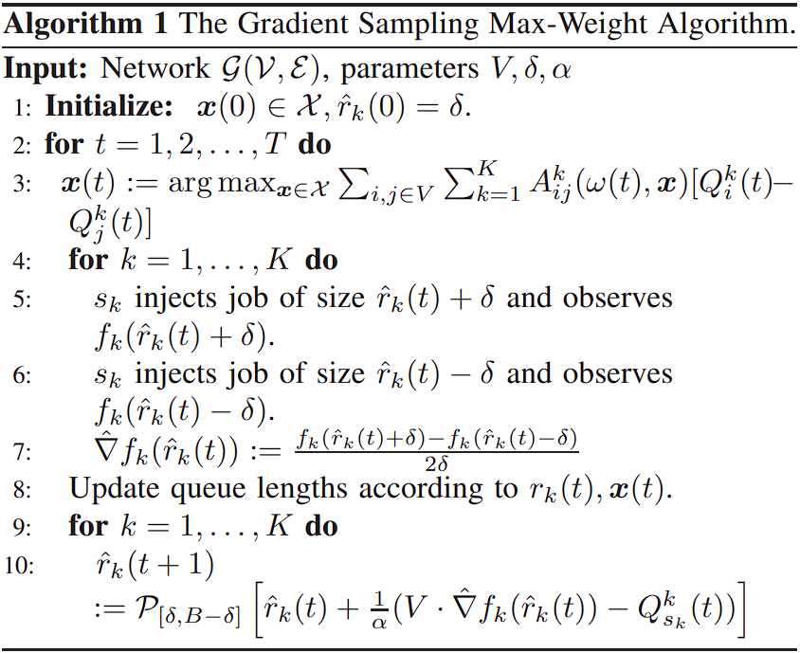

GSMW Algorithm
Gradient Sampling Max-Weight
Gradient sampling
Drift-plus-penalty
Backpressure routing
Max-Weight scheduling
No-delay setting:
Notes:
Drift-plus-penalty optimization: stabilizing a queueing network while also minimizing the time average of a network penalty function
If there is no penalty to be minimized, it becomes backpressure routing
Backpressure routing: Each job can visit multiple service nodes (multihop)
If each job visits only a single service node, it becomes Max-Weight scheduling
Max-Weight scheduling: algorithm for directing traffic around a queueing network that achieves maximum network throughput.
Parameters: V controls the relative weights of gradient and queue length while α determines the step size

Slide 9
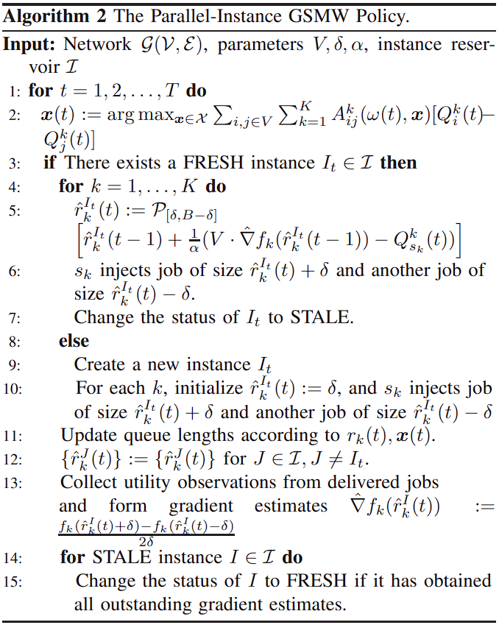
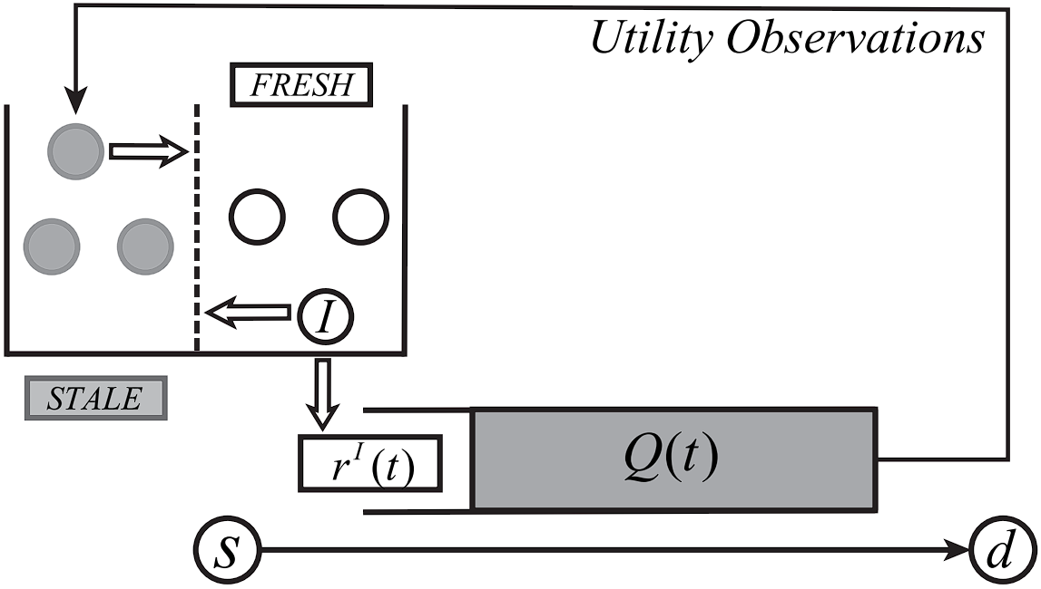
P-GSMW Algorithm
Parallel-instance Gradient Sampling Max-Weight
Two status: FRESH and STALE
Notes:
Set of parallel instances of GSMW is invoked.
FRESH status means that the instance has obtained the corresponding utility feedback and can perform updates on the virtual job-size variables (Line 5 of Algorithm 2); STALE status means that the instance is still waiting for utility feedback
Figure: A single-queue example of the parallel-instance paradigm

Slide 10
Applications
Database query
Job scheduling
Video streaming

Slide 11

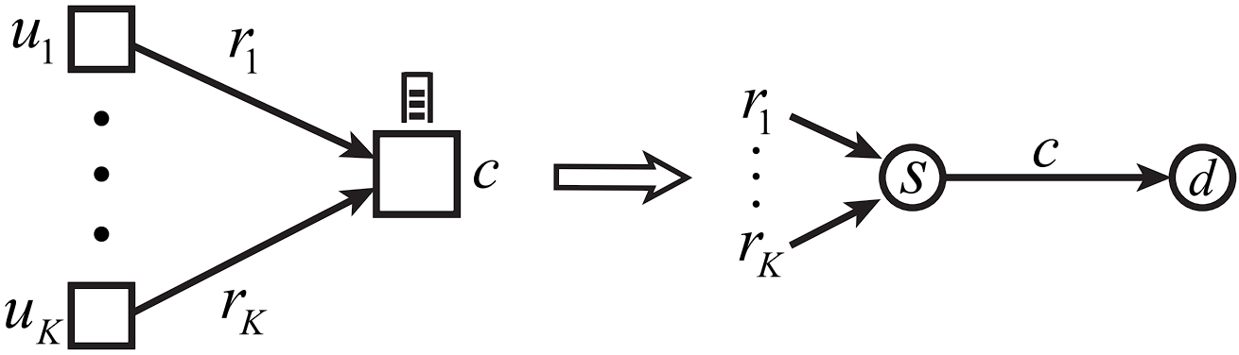
Database Query
K users querying a central database
Maximize total utililty of the processed queues
Sublinear regret value:
Notes:
rk : Query size
c: Unit of requests that database can process
S: source
d: destination
Figure: Correspondence between database query and the Learning-NUM framework.

Slide 12
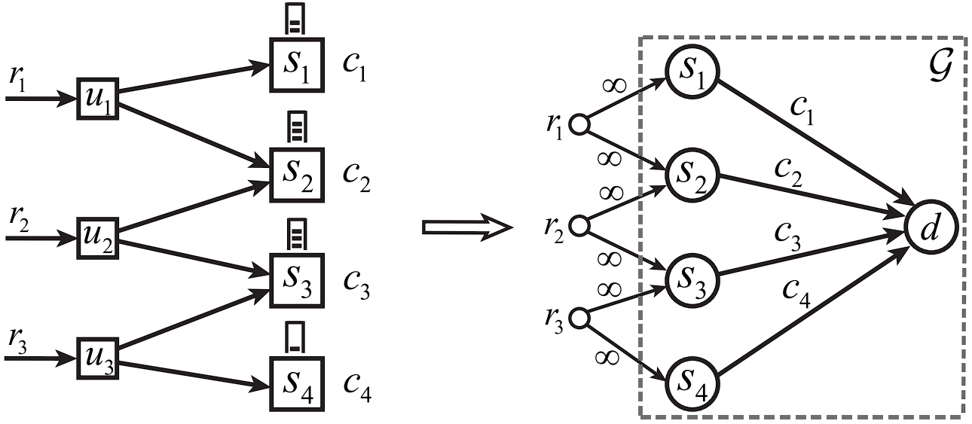
Job Scheduling
3 Job schedulers and 4 servers
Dispatcher determines resource
Maximize the total utility gained from jobs
Example of ML in Cloud
Sublinear regret value:
Notes:
Dispatcher (job scheduler) determines resource (computation, memory) requirement
model training for machine learning tasks in cloud computing
Figure: Correspondence between job scheduling and the Learning-NUM framework

Slide 13
Video Streaming
Discuss the advantages of Learning-NUM, such as accuracy and efficiency
K users streaming video from K servers
Servers send chunks to users
Determining size of the video chunks
Maximizing delivered video chunks
Sublinear regret value:
Notes:
Chunks of video file are sent to users from corresponding servers

Slide 14
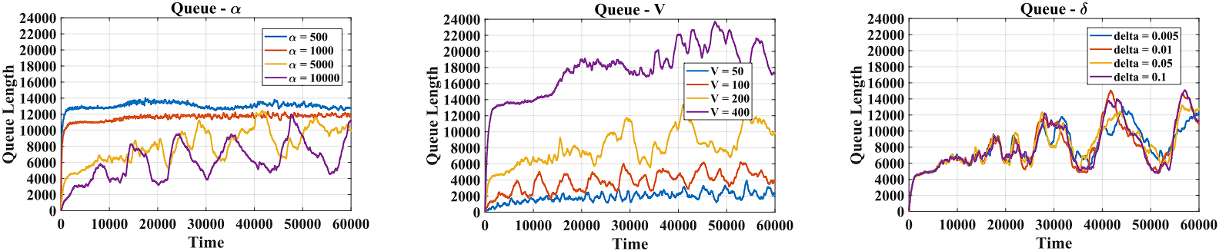
Evaluation: Parameters
α: Controls the step size with a larger α indicating a smaller step size.
V: Adjusts the relative weights on utility maximization and queue stability, with a larger V indicating that the policy tries to increase the job sizes more aggressively.
δ: Controls the approximation error of our estimate gradients with respect to the true gradients.
Notes:
Simulation results are given in these slides…
For parameter V, increasing job sizes also increase the instantaneous utility
Delta parameter do not have a significant effect

Slide 15
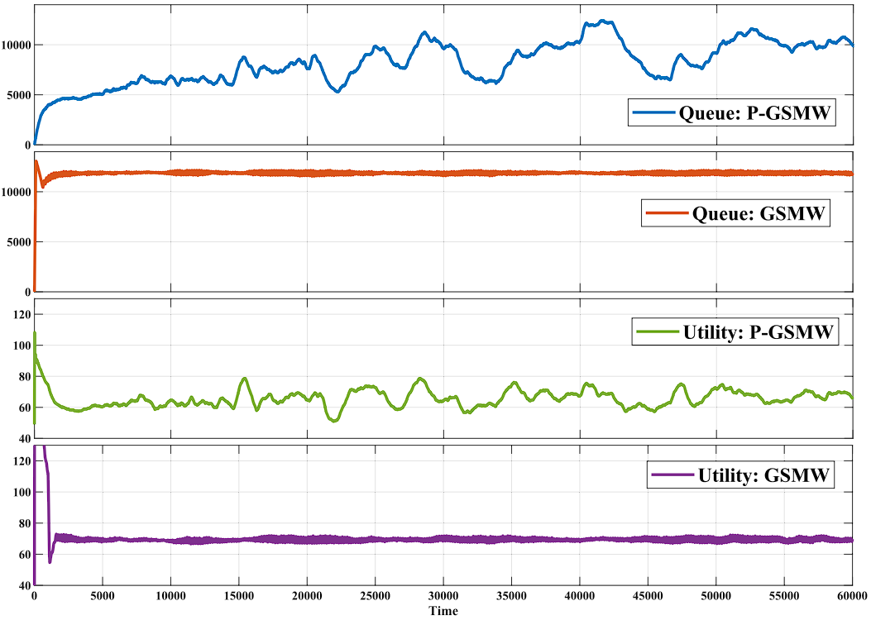
Evaluation
Queue length and instantaneous utility behavior under P-GSMW and GSMW:

Slide 16
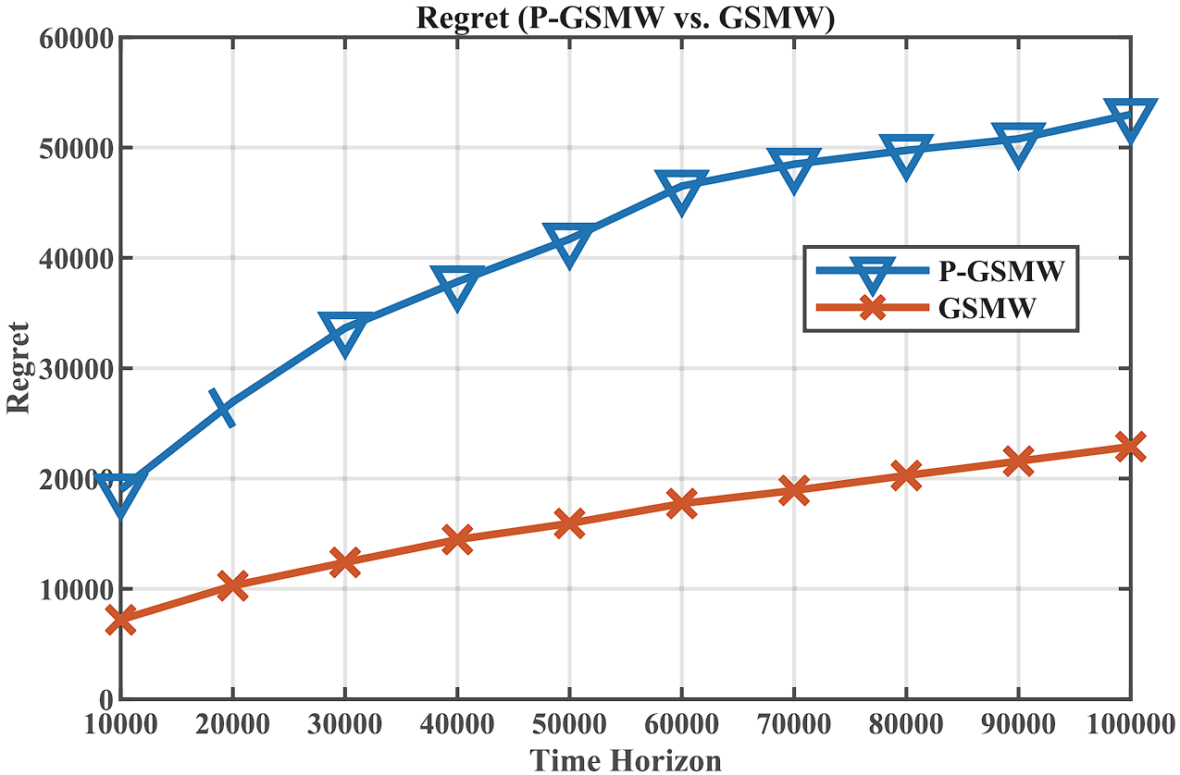
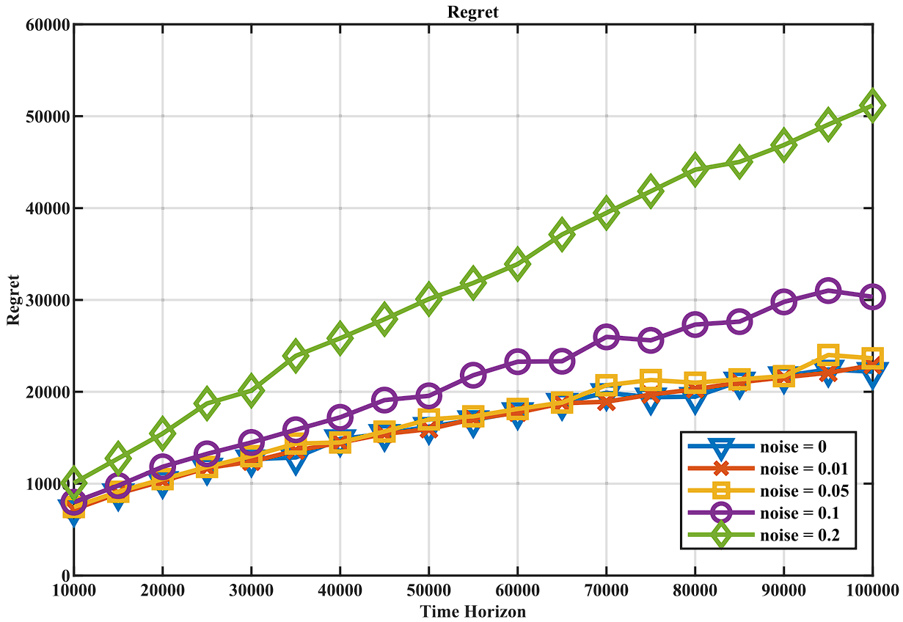
Evaluation
Regrets of P-GSMW and GSMW:
Notes:
Feedback delay exists, that’s why P-GSMW is worse.

Slide 17
Conclusion
A new framework: Learning-NUM
With unknown utility functions and queueing-style delay
Achieved sub-linear regret
Future work:
Noiseless, no-delay case does not achieve lower bound of regret
More robust policies for noisy scenarios
Notes:
utility functions are only accessible through zeroth-order feedback and the feedback experiences queueing-style delay
There can be ways to decrease regret value more, because we do not reach to the lower bound

Slide 18
References
[1] X. Fu and E. Modiano, "Learning-NUM: Network Utility Maximization With Unknown Utility Functions and Queueing Delay," in IEEE/ACM Transactions on Networking, vol. 30, no. 6, pp. 2788-2803, Dec. 2022, doi: 10.1109/TNET.2022.3182890.
[2] Wikipedia contributors. (2022, June 2). Drift plus penalty. In Wikipedia, The Free Encyclopedia. Retrieved 21:49, May 2, 2023, from https://en.wikipedia.org/w/index.php?title=Drift_plus_penalty&oldid=1091167397
[3] Wikipedia contributors. (2021, September 21). Backpressure routing. In Wikipedia, The Free Encyclopedia. Retrieved 21:49, May 2, 2023, from https://en.wikipedia.org/w/index.php?title=Backpressure_routing&oldid=1045657229
[4] Wikipedia contributors. (2023, February 2). Regret (decision theory). In Wikipedia, The Free Encyclopedia. Retrieved 21:51, May 2, 2023, from https://en.wikipedia.org/w/index.php?title=Regret_(decision_theory)&oldid=1137023034

